Slide 1

Final Project Predicting Cryptocurrency Prices Via LSTM Networks
James Burns
CSCI S-89 Introduction to Deep Learning
Summer 2021
Harvard Summer School

Slide 2
Introduction via Questions
What is cryptocurrency?
What are cryptocurrency prices based on?
What is blockchain technology?
Why was it developed?
How much is it all worth?
What data inputs are proven to predict fair price valuations?
What deep learning methods will be used to explore price fundamentals?
Does your model work, James?

Slide 3
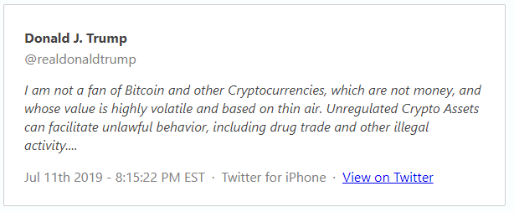
Problem Statement: Prices Based on Thin Air?
https://www.thetrumparchive.com/?searchbox=%22thin+air%22

Slide 4

What is Cryptocurrency?
https://www.vectorstock.com/royalty-free-vector/cryptocurrency-infographic-10-steps-concept-vector-27840819

Slide 5
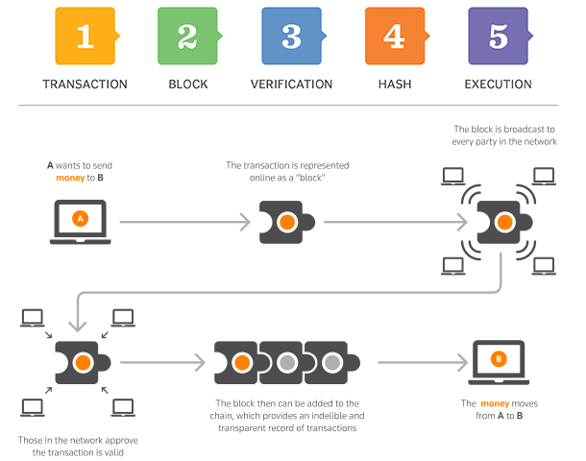
Blockchain Technology?
https://www.garyfox.co/how-blockchain-works-infographic/

Slide 6
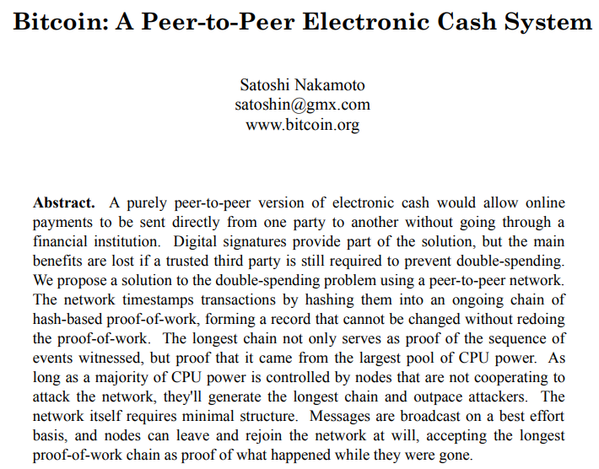
Why Create Cryptocurrency?
https://bitcoin.org/bitcoin.pdf

Slide 7
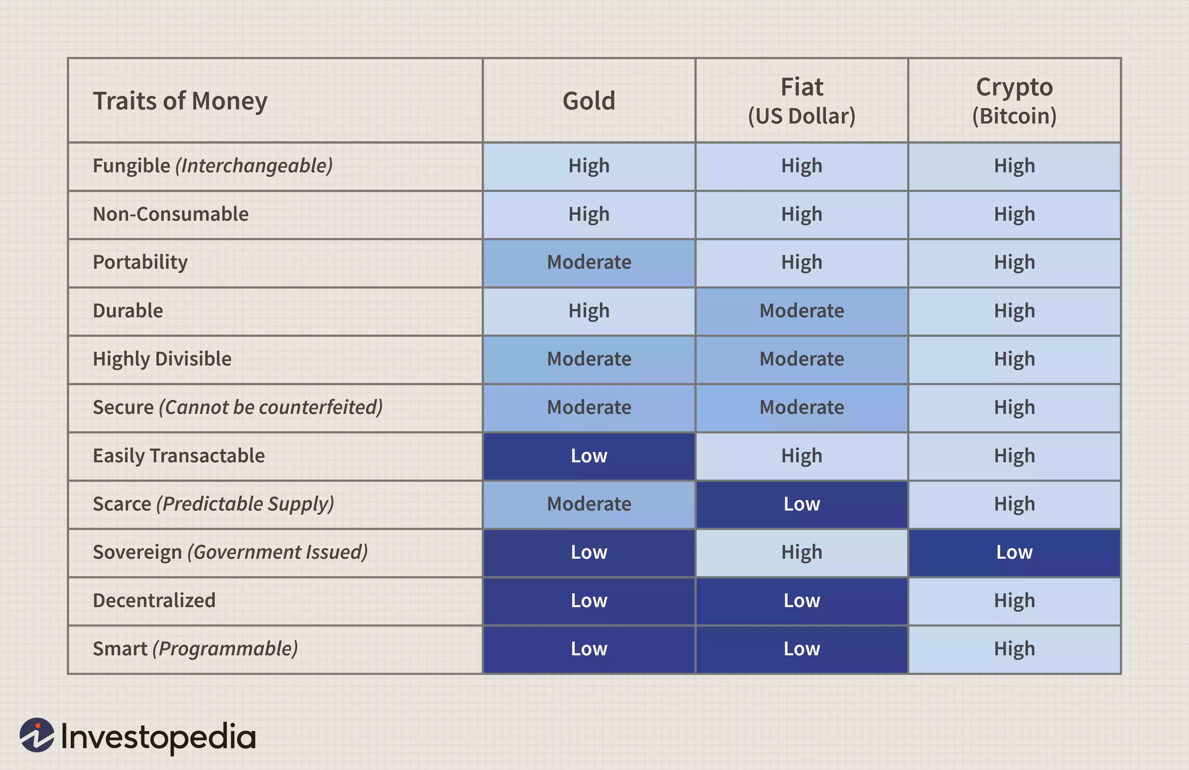
Worth of Cryptocurrency?
Image by Sabrina Jiang © Investopedia 2020

Slide 8
What Data Predicts Price?
Hashrate
Active Accounts
According to Bhambwhani et al. (2019)

Slide 9
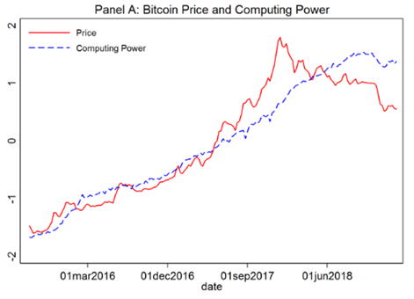
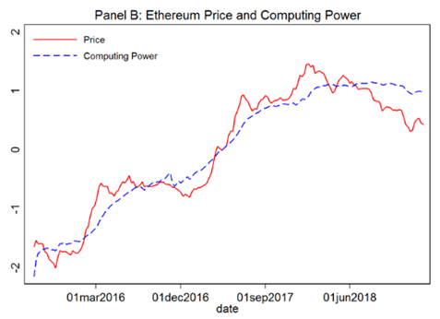
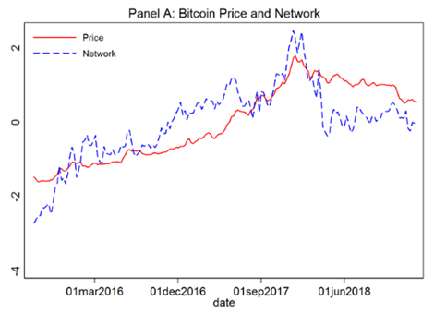
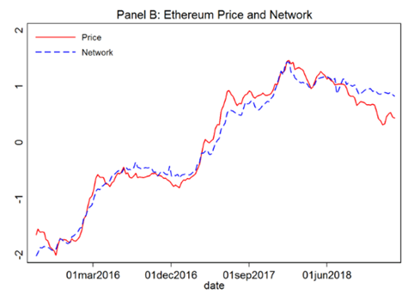
Hashrate & Active Accounts?
Bhambwhani et al. (2019)

Slide 10
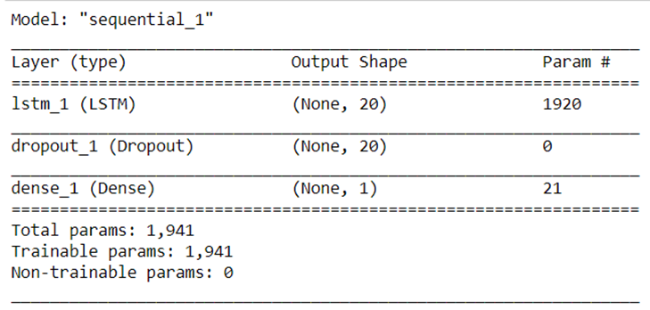
Methodology: LSTM Network

Slide 11
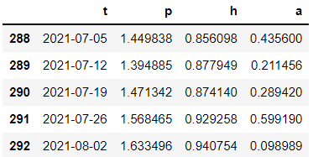
Data Inputs
#Convert data into 3d array of
# shape (observations over time, n_timesteps, n_vars)
n_timesteps = 8
features_set_price = []
labels_price = []
for i in range(n_timesteps, xt.shape[0]):
features_set_price.append(xt[i-n_timesteps:i,1]) #prices
labels_price.append(xt[i,1])
features_set_hash = []
labels_hash = []
for i in range(n_timesteps, xt.shape[0]):
features_set_hash.append(xt[i-n_timesteps:i,2])
labels_hash.append(xt[i,2])
features_set_accounts = []
labels_accounts = []
for i in range(n_timesteps, xt.shape[0]):
features_set_accounts.append(xt[i-n_timesteps:i,3])
labels_accounts.append(xt[i,3])

Slide 12
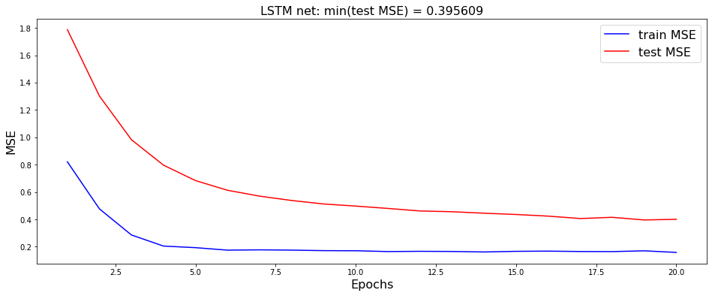
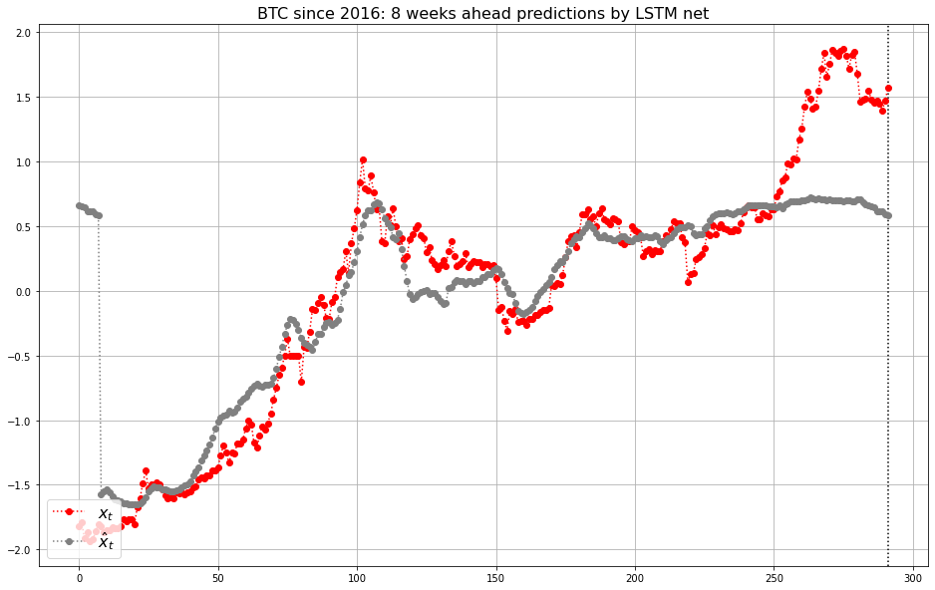
Model 1: Bitcoin Baseline
Good models are evaluated based on graphical evidence. A gray prediction line that precedes the red actual line is the goal.

Slide 13
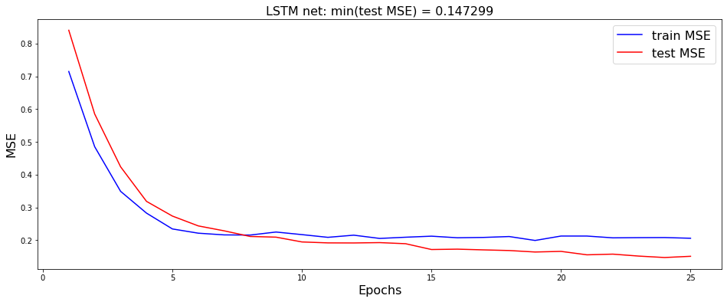
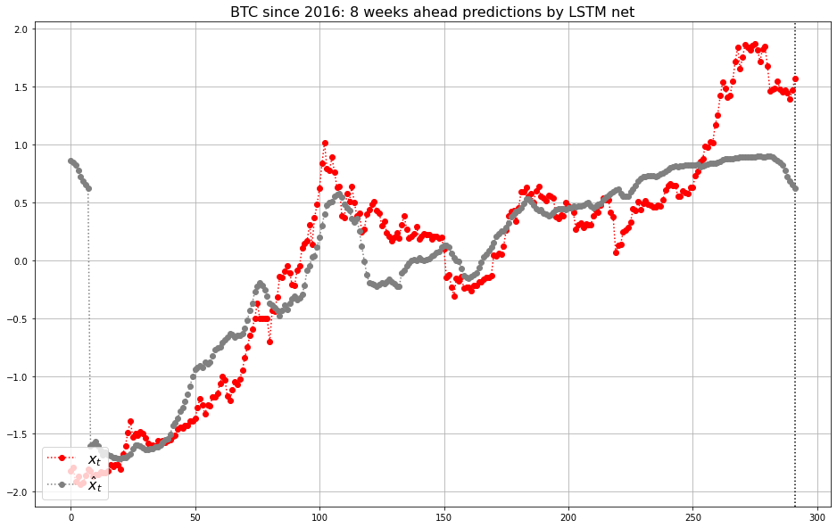
Model 2: Bitcoin Improved

Slide 14
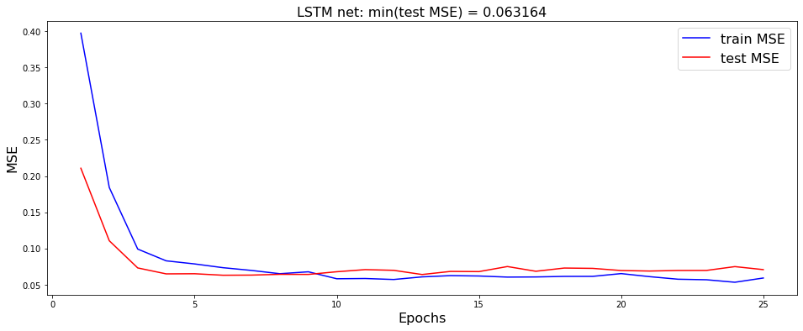
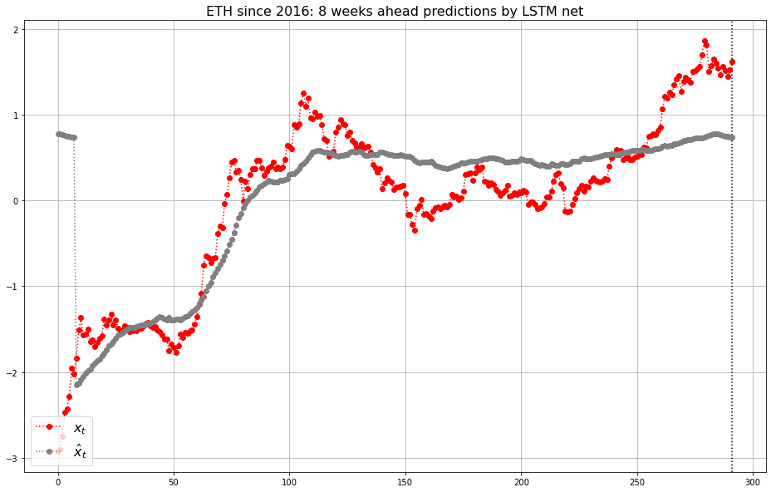
Model 3: Baseline Ethereum

Slide 15
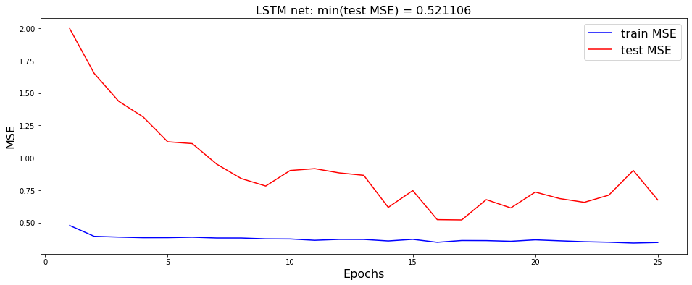
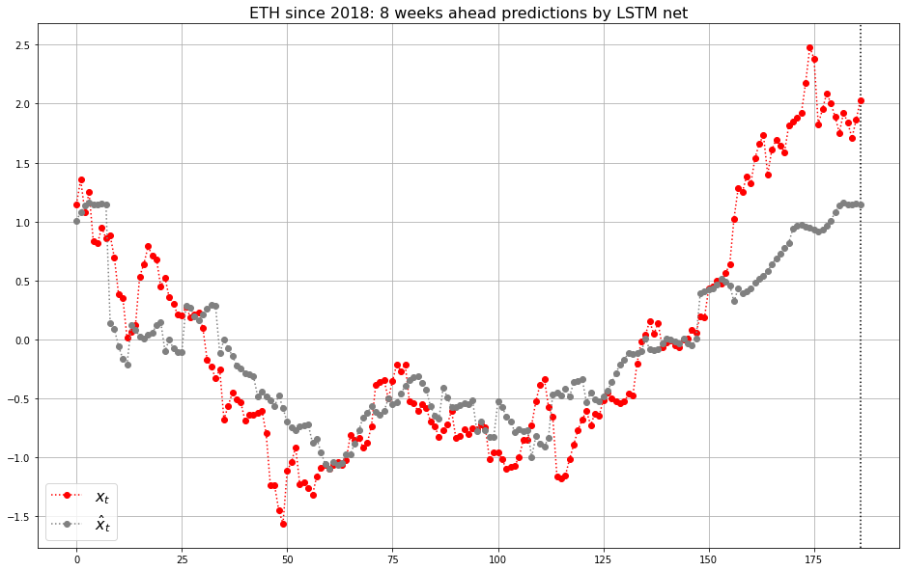
Model 4: Ethereum Since 2018

Slide 16
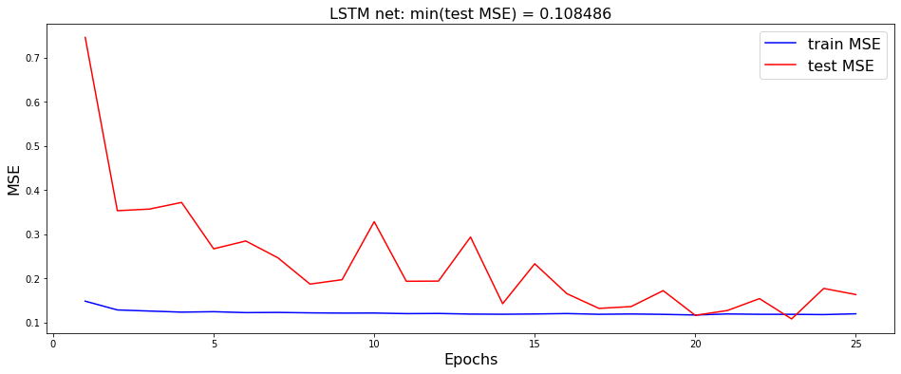
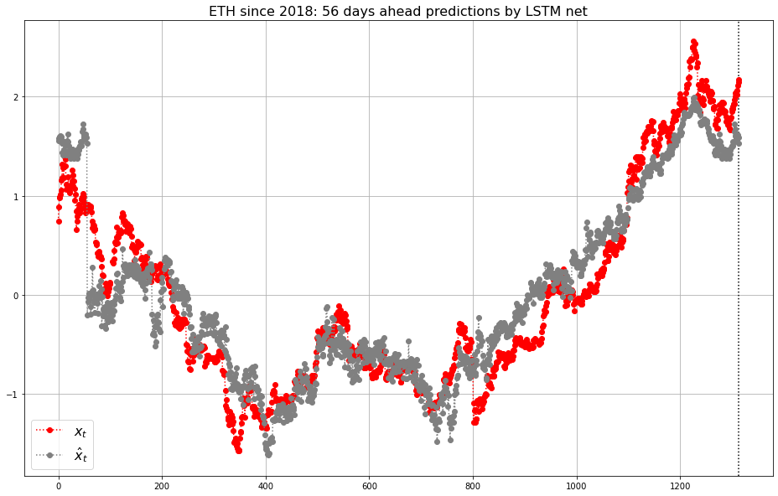
Model 5: Ethereum Daily

Slide 17
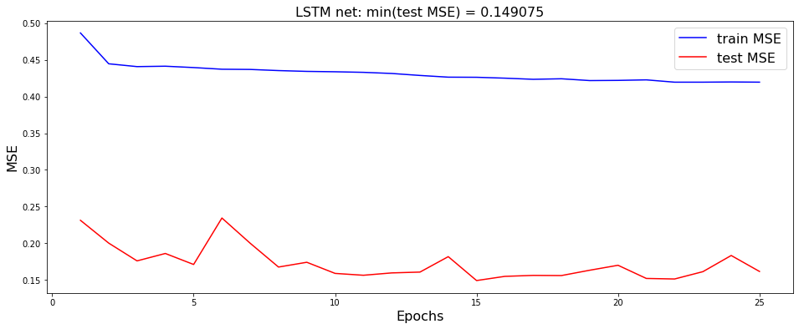
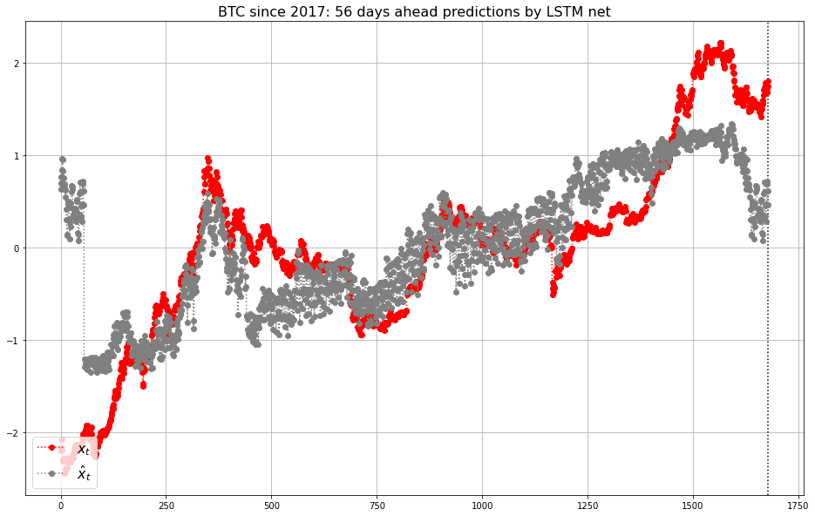
Model 6: Improved Bitcoin Daily Since 2017

Slide 18
Weaknesses
The models are currently only evaluated based on MSE and subjective graphical evidence.
The models do not adjust sufficiently for the asset inflationary pressures experienced during the current COVID event
The relationships between the hashrate and active accounts factors vary substantially in Ethereum versus Bitcoin. More predictors would be necessary to build a strong Ethereum predictive value model.
The model relies on hashrate, from Proof-of-work, which is an increasingly less popular security method. Some measure of Proof-of-stake blockchain data will have to replace this metric in the future for Ethereum.

Slide 19
Strengths
The models predict the price movement of Bitcoin well, and with the inflation proxy input adjustment, could be used to evaluate current valuations.
The models run very quickly and easily for a variety of timeframes and assets
The graphical output allows for quick evaluation of the quality of predictions, given those inputs and timeframe
This model seeks to predict what a cryptocurrency should be worth. There are no alternatives available publicly. This is cutting edge finance exploration. Try Googling if Bitcoin is overvalued, you’ll get no useful information.

Slide 20
YouTube Video Presentation
YouTube video presentation:
https://youtu.be/z9wtH0cNggY

